Slide 1
Project 2 : Data Harmonization and Insights Extraction
Gurpreet kaur
Submission Date: 14 Jan 2025

Slide 2
Project Overview
Overview: Addressing inconsistencies across three datasets to create a unified and clean dataset for analysis.
Problem Statement:
Address ambiguities and inconsistencies in multiple datasets.
Leverage advanced data-wrangling techniques to produce a clean, unified dataset.
Objective:
Develop a well-integrated dataset for business analysis and predictive modeling.
Deliverables:
Cleaned and merged dataset.
Comprehensive analysis with visualizations and insights.

Slide 3
Dataset Details
Attributes Overview:
Date: Ride date.
Season: - 1 = spring, 2 = summer, 3 = fall, 4 = winter.
Holiday: Binary indicator of holidays.
Working Day: Binary indicator of non-weekends/non-holidays.
Weather: Categorical, from clear to severe weather.
Temp: Feels-like temperature (°C).
Humidity: Relative humidity (%).
Windspeed: Measured in km/h.
Casual: Non-registered user rentals.
Registered: Registered user rentals.
Count: Total rentals.

Slide 4
Tools and Techniques
Tools:
Pandas: Data manipulation.
NumPy: Numerical computations.
Seaborn & Matplotlib: Data visualization.
Warnings: ignore warnings
Techniques:
Dataset merging and harmonization.
Imputation of missing values.
Outlier detection and capping.
Statistical and exploratory analysis.

Slide 5
Data Wrangling Process
Phase 1: Data Acquisition
Loaded datasets into Python.
Initial inspection using .info() and .head().
Documented quality and completeness issues . Describe().
Phase 2: Dataset Integration
Week 1: Dataset_1 and Dataset_2
Merged datasets on common keys.
Handled missing values using mean/mode imputation.
Dropped duplicates and unnecessary columns such as yr and Unnamed: 0.
Week 2: Dataset_3
Concatenated Dataset_3 to the merged dataset.
Applied missing value analysis and outlier detection.
Used interpolation and capping to address data gaps and anomalies.

Slide 6
Key Challenges and Solutions
Challenges:
Missing values in critical attributes.
Outliers impacting analysis.
Integrating datasets with inconsistent formats.
Solutions:
Applied mean/median imputation.
Detected outliers using boxplots and capped extreme values.
Standardized formats and validated data integrity.

Slide 7
Advanced Analysis
Skewness and Transformations:
Skewed attributes normalized using log transformations.
Correlation Analysis:
Key relationships identified:
Temp vs. Count
Humidity vs. Count
Windspeed vs. Count
Visualizations:
Heatmap: Correlation matrix of key attributes.
Scatter Plots: Relationship between environmental factors and rentals.
Boxplots: Outlier analysis before and after capping.

Slide 8
Insights and Findings
Trends:
Rental counts strongly correlated with temperature.
High humidity reduced rental activity.
Outliers:
Significant anomalies detected in windspeed and temperature were mitigated.
Impact:
Prepared dataset ensures robustness for predictive modeling.
Cleaned data aligns with business objectives for accurate insights.

Slide 9
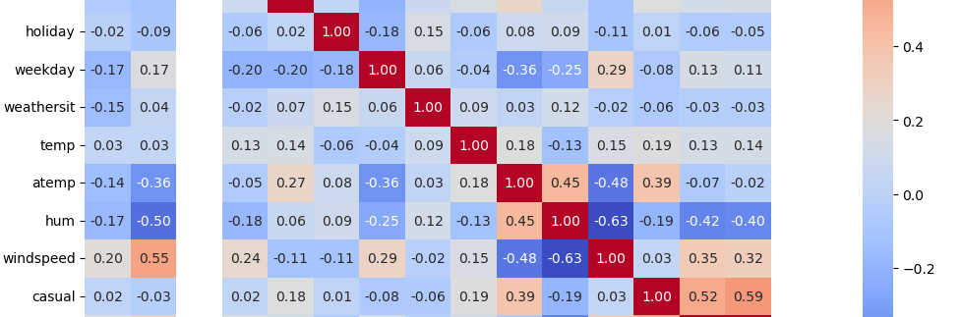
HeatMap

Slide 10
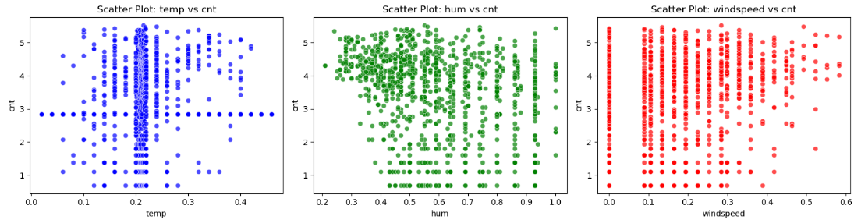
Scatter Plot

Slide 11
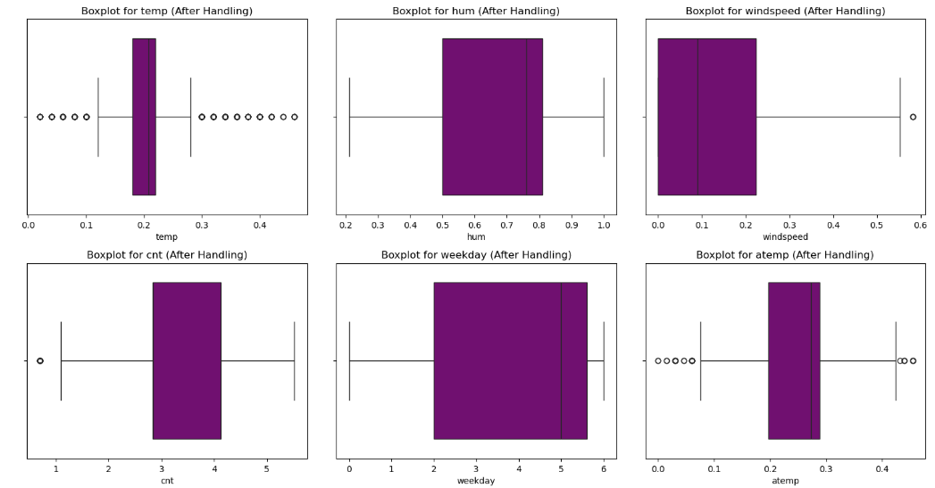
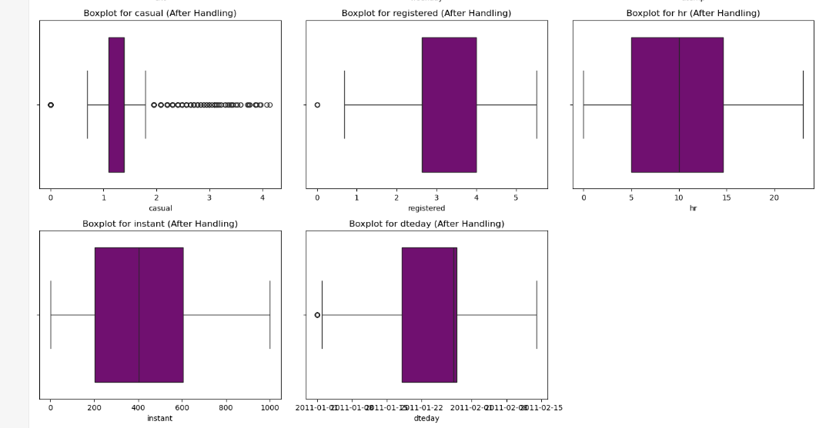
Boxplot

Slide 12

Thanks, You

